Slide 1
Integer primitive data types

Slide 2
Outline
In this lesson, we will:
Learn the representation of unsigned integers
Describe how integer addition and subtraction is performed
This requires the 2’s complement representation
Use 2’s complement to store negative numbers for signed integers
Describe the ranges stored by the four integer types
Both unsigned and signed

Slide 3
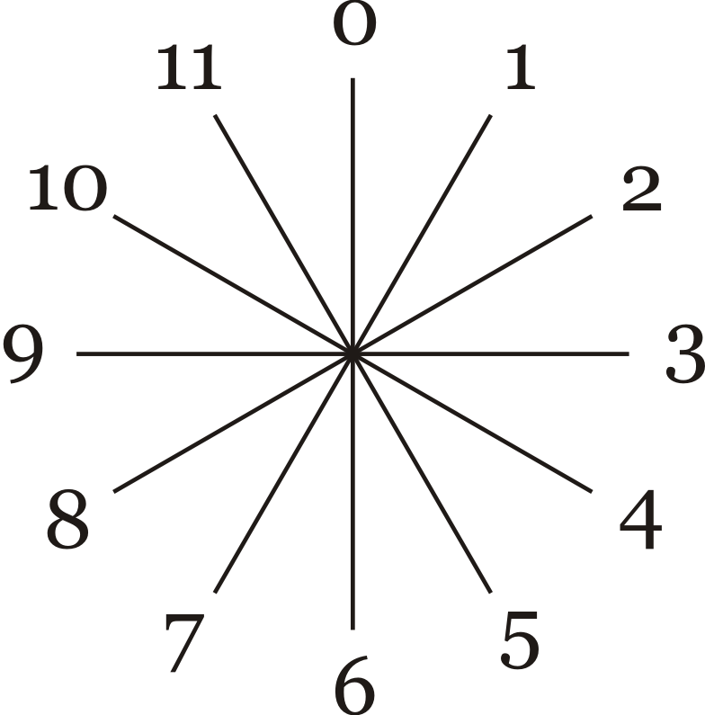
Clock arithmetic
Suppose we have a clock face, but define 12 o’clock as “0” o’clock
The Europeans and military already do this…
You know that:
5 hours after 9 o’clock is 2 o’clock
7 hours before 3 o’clock is 8 o’clock
Specifically:
1 hour before 0 o’clock is 11 o’clock
1 hour after 11 o’clock is 0 o’clock
This is arithmetic modulo 12

Slide 4
int and long
We have seen integer data types up to this point:
int
unsigned int
long
unsigned long
It has been suggested that
An unsigned integer stores only positive numbers (0, 1, 2, …)
A long can store more information than an int
We will now see how integers are stored in the computer

Slide 5
Binary representations
We have already described binary numbers
On the computer, all integers are stored in binary
Thus, to store each of these numbers, we must store the corresponding binary digits (bits):
3 11 2
42 101010 6
616 1001101000 10
299792458 10001110111100111100001001010 29
To store a googol (10¹⁰⁰), we must store 333 bits:
10010010010011010110100100101100101001100001101111100111…01011000010110010011110000100110001001100111000001011111…10011100010101100111001000000100011100010000100011010011…11100101010101011001001000011000010001010100000101110100…01111000100000000000000000000000000000000000000000000000…00000000000000000000000000000000000000000000000000000

Slide 6
Storage
Do we store as many bits as are necessary?
You could, but this would be exceedingly difficult to manage
Instead, each primitive data type has a fixed amount of storage
8 bits are defined as 1 byte
All data types are an integral number of bytes
Usually 1, 2, 4, 8 or 16 bytes
Because we use binary, powers of 2 are very common:
Exponent | Decimal | Binary
2⁰ | 1 | 1
2¹ | 2 | 10
2² | 4 | 100
2³ | 8 | 1000
2⁴ | 16 | 10000
2⁵ | 32 | 100000
2⁶ | 64 | 1000000

Slide 7
unsigned int
A variable is declared unsigned int is allocated four bytes
4 bytes is 4 × 8 = 32 bits
32 different 1s and 0s can be stored
The smallest and largest:
00000000000000000000000000000000
11111111111111111111111111111111
The smallest represents 0
The largest is one less than
This equals 2³², thus, the largest value that can be stored as an unsigned int is 2³² – 1 = 4294967295
Approximately 4 billion

Slide 8
unsigned short
Sometimes, you don’t need to store numbers this large
Variables declared unsigned short are allocated two bytes
2 bytes is 2 × 8 = 16 bits
16 different 1s and 0s can be stored
The smallest and largest:
0000000000000000
1111111111111111
The smallest represents 0
The largest is one less than
This equals 2¹⁶, thus, the largest value that can be stored as an unsigned int is 2¹⁶ – 1 = 65535

Slide 9
unsigned long
Sometimes, you need to store very large numbers
Variables declared unsigned long are allocated eight bytes
8 bytes is 8 × 8 = 64 bits
64 different 1s and 0s can be stored
The smallest and largest:
0000000000000000000000000000000000000000000000000000000000000000
1111111111111111111111111111111111111111111111111111111111111111
The smallest represents 0
The largest is one less than
This equals 2⁶⁴, thus, the largest value that can be stored as an unsigned int is 2⁶⁴ – 1 = 18446744073709551615
This 18 billion billion or 18 quintillion

Slide 10
Example
Consider this program:
#include <iostream>
// Function declarations
int main();
// Function definitions
int main() {
unsigned short a{42};
unsigned int b{207500};
unsigned long c{299792458};
std::cout << (a + b + c) << std::endl;
return 0;
}
Note:
First, a is upcast to unsigned int
before to the first addition
Then, the result is upcast to
unsigned long before the second addition
Output:
300000000

Slide 11
Example
On the stack, an appropriate number of bytes are allocated to each variable
#include <iostream>
// Function declarations
int main();
// Function definitions
int main() {
unsigned short a{42};
unsigned int b{207500};
unsigned long c{299792458};
std::cout << (a + b + c) << std::endl;
return 0;
}

Slide 12
Example
Each of these variables is then initialized
#include <iostream>
// Function declarations
int main();
// Function definitions
int main() {
unsigned short a{42};
unsigned int b{207500};
unsigned long c{299792458};
std::cout << (a + b + c) << std::endl;
return 0;
}

Slide 13
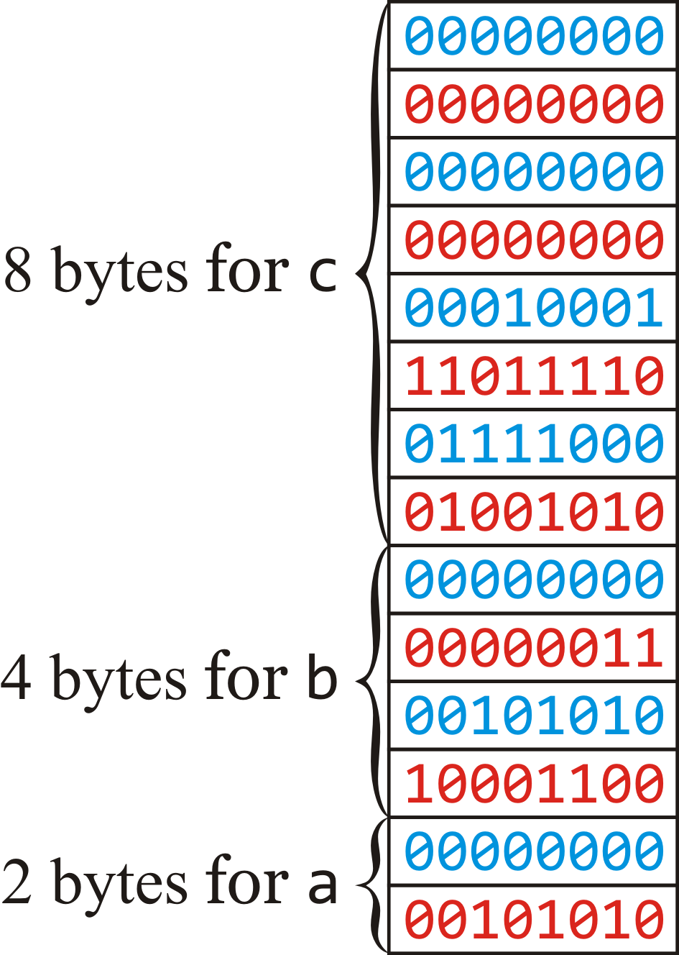
Example
Generally, however, we display the bytes in memory as a column of bytes, the values of which are concatenated
#include <iostream>
// Function declarations
int main();
// Function definitions
int main() {
unsigned short a{42};
unsigned int b{207500};
unsigned long c{299792458};
std::cout << (a + b + c) << std::endl;
return 0;
}

Slide 14
Wasted space?
If an integer does not use all the bytes, the remaining bits are never-the-less allocated until the variable goes out of scope
In general-purpose computing, this is often not a problem
This is a critical issue, however, in embedded systems
More memory:
Costs more
Uses more power
Produces more heat

Slide 15
Determining the size of a type
We have said short, int and long are 2, 4 and 8 bytes
This is true on most every general-purpose computer
Unfortunately, the C++ specification doesn’t require this
Fortunately, the sizeof operator gives you this information
#include <iostream>
int main();
int main() {
std::cout << "An 'unsigned short' occupies "
<< sizeof ( unsigned short ) << " bytes" << std::endl;
std::cout << "An 'unsigned int' occupies "
<< sizeof ( unsigned int ) << " bytes" << std::endl;
std::cout << "An 'unsigned long' occupies "
<< sizeof ( unsigned long ) << " bytes" << std::endl;
return 0;
}
Output on ecelinux:
An 'unsigned short' occupies 2 bytes
An 'unsigned int' occupies 4 bytes
An 'unsigned long' occupies 8 bytes

Slide 16
Memory and initial values
Question:
What happens if the initial value cannot be stored?
#include <iostream>
int main();
int main() {
unsigned short c{299792458};
std::cout << "The speed of light is " << c
<< " m/s." << std::endl;
return 0;
}

Slide 17
Memory and initial values
Fortunately, you get a warning:
example.cpp: In function 'int main()':
example.cpp:6:31: warning: narrowing conversion of â299792458â from 'int' to 'short unsigned int' inside { } [-Wnarrowing]
unsigned short c{299792458};
^
example.cpp:6:31: warning: large integer implicitly truncated to unsigned
type [-Woverflow]
It still compiles and executes:
The speed of light is 30794 m/s.

Slide 18
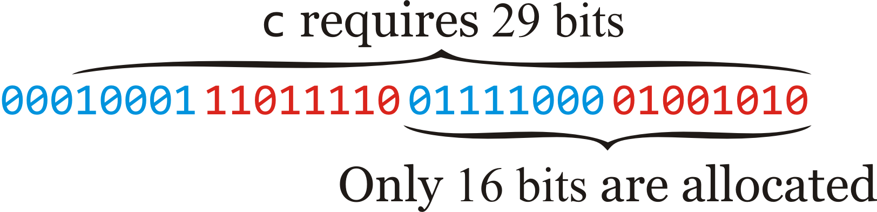
Memory and initial values
Where does 30794 come from?
The binary number 0b111100001001010 equals 30794 in base 10

Slide 19
Memory and initial values
Important:
All unsigned integers are stored:
modulo 2¹⁶ for unsigned short
modulo 2³² for unsigned int
modulo 2⁶⁴ for unsigned long

Slide 20
Memory and arithmetic
What happens if the sum, difference or product of two integers exceeds what can be stored?
#include <iostream>
int main();
int main() {
unsigned short m1{40000}, m2{42000};
int n1{40000}, n2{42000};
unsigned short sum{m1 + m2}, diff{m1 - m2}, prod{m1*m2};
std::cout << sum << "\t" << (n1 + n2) << std::endl;
std::cout << diff << "\t" << (n1 - n2) << std::endl;
std::cout << prod << "\t" << (n1*n2) << std::endl;
return 0;
}
Output:
16464 82000
63536 -2000
50176 1680000000

Slide 21
Memory and arithmetic
Let’s look at the actual values and the evaluated results:
16464 0100000001010000
82000 10100000001010000
63536 1111100000110000
–2000 -0000011111010000
50176 1100010000000000
1680000000 1100100001000101100010000000000
For the sum and product, the result ignores the higher-order bits
The negative number is a little odd….

Slide 22
Memory and arithmetic
What happens if the sum, difference or product of two integers exceeds what can be stored?
#include <iostream>
int main();
int main() {
unsigned short smallest{0}, largest{65535};
std::cout << "Smallest: " << smallest << std::endl;
std::cout << "Largest: " << largest << std::endl;
--smallest;
++ largest;
std::cout << "Smallest minus 1: " << smallest << std::endl;
std::cout << "Largest plus 1: " << largest << std::endl;
return 0;
}
Output:
Smallest: 0
Largest: 65535
Smallest minus 1: 65535
Largest plus 1: 0

Slide 23
Memory and arithmetic
Important:
All unsigned integers arithmetic is performed:
modulo 2¹⁶ for unsigned short
modulo 2³² for unsigned int
modulo 2⁶⁴ for unsigned long
This is similar to all clock arithmetic being performed modulo 12

Slide 24
Addition
Addition is easy:
Like in elementary school, line them up and occasionally you require a carry in the next column:
The rules are:
0 + 0 → 0
0 + 1 → 1
1 + 1 → 10 → 0 with a carry of 1
1 + 1 + 1 → 11 → 1 with a carry of 1
For example, adding two unsigned short:
1 1 1 1 1 1
0101000111010110
+ 1001101011000100
1110110010011010
20950
39620
60570

Slide 25
Addition
What if we go over? Adding these two unsigned short:
1 1 1 1 1 1 1
1101000111010110
+ 1001101011000100
10110110010011010
The additional bit is discarded—addition is calculated modulo 2¹⁶
Thus, the answer is 110110010011010 which is 27802
53718
39620
93338

Slide 26
Subtraction
Subtraction is more difficult:
Like in elementary school, you learned to “borrow”, but borrowing may require you to look way ahead:
0100000001010000
- 0001101011000101
?
Our salvation: we are performing arithmetic modulo 65536

Slide 27
Subtraction
Going back to the clock:
Subtracting 10 is the same as adding 2
Subtracting 4 is the same as adding 8
Subtracting 9 is the same as adding 3
Thus, to subtract n, add 12 – n
In our case, to subtract n, add 65536 – n
1 1 1 1 1
0100000001010000 0100000001010000
- 0001101011000101 + 1110010100111011
? 10010010110001011
The answer is 0010010110001011
16464
6853
58683
9611

Slide 28
Subtraction
The million-dollar question:
How do you calculate 65536 – n???
Subtract any number from 9999999999999, no borrows are needed
9999999999999
– 5501496383498
4498503616501
Thus, to calculate 10000000000000 – n, instead calculate
(10000000000000 – 1) – n + 1 = (9999999999999 – n) + 1
For example:
10000000000000
– 5501496383498
4498503616502
This is called the base-10 complement
or “10’s complement”
– this is how older adding machines
performed subtraction

Slide 29
Subtraction
In binary, the equivalent is base-2 complement or “2’s complement”
To calculate 65536 – 1970, calculate (65535 – 1970) + 1:
1111111111111111
– 0000011110110010
1111100001001101
+ 1
1111100001001110
Thus, to calculate 2018 – 1970, just add the 2’s complement of 1970 to 2018:
0000011111100010
+ 1111100001001110
10000000000110000
This is the binary representation of 48 = 2⁵ + 2⁴ = 32 + 16
Remember, we ignore the leading 1

Slide 30
2’s complement
To calculate the 2’s complement:
Complement all of the bits in the number
This includes leading zeros
Add 1
For example, the 2’s complement of the speed of light is stored as an unsigned int is
00010001110111100111100001001010
11101110001000011000011110110101
+ 1
11101110001000011000011110110110

Slide 31
2’s complement
There is a faster way to compute it without the addition:
Scan from right-to-left
Find the first 1, and then flip each bit to the left of that
The 2’s complement of each of the following is given below it
1011011111011111
0100100000100001
1010111111100000
0101000000100000
0000100100101100
1111011011010100

Slide 32
2’s complement
The 2’s complement of 0 stored as an unsigned int is
00000000000000000000000000000000
11111111111111111111111111111111
+ 1
100000000000000000000000000000000
This makes sense: any number minus zero is unchanged

Slide 33
2’s complement
The 2’s complement algorithm is self-inverting:
If n is a number, then 2¹⁶ – (2¹⁶ – n) = n
The 2’s complement of the 2’s complement of a number is the number itself
1110110010111110
0001001101000001
+ 1
0001001101000010
1110110010111101
+ 1
1110110010111110
That is, f ^{–1} = f or f(f(n)) = n

Slide 34
Memory and arithmetic
Try it yourself:
#include <iostream>
int main();
//////////////////////////////////////////////////
// Verify that every possible sum, difference,
// product, division and remainder option on
// 'unsigned short' is the actual operation
// modulo 65536
//////////////////////////////////////////////////
int main() {
long const TWO_15{32768};
long const TWO_16{2*TWO_15};
for ( long i{0}; i < TWO_16; ++i ) {
// Just print out the count when we get to multiples of 1024
if ( (i % 1024) == 0 ) {
std::cout << i << std::endl;
}
for ( long j{0}; j < TWO_16; ++j ) {
unsigned short si{i};
unsigned short sj{j};
// Perform the sum as unsigned shorts and as signed longs
unsigned short sk{si + sj};
long k{(i + j) % TWO_16};
if ( k < 0 ) {
k += TWO_16;
}
// If they differ, print out a warning
if ( k != sk ) {
std::cout << i << " + " << j << " = " << k
<< " != " << sk << std::endl;
}
// Perform the difference as unsigned shorts and as signed longs
sk = si - sj;
k = (i - j) % TWO_16;
if ( k < 0 ) {
k += TWO_16;
}
// If they differ, print out a warning
if ( k != sk ) {
std::cout << i << " - " << j << " = " << k
<< " != " << sk << std::endl;
}
// Perform the difference as unsigned shorts and as signed longs
sk = si * sj;
k = (i * j) % TWO_16;
if ( k < 0 ) {
k += TWO_16;
}
// If they differ, print out a warning
if ( k != sk ) {
std::cout << i << " * " << j << " = " << k
<< " != " << sk << std::endl;
}
// We cannot perform division or remainder when the
// second operand is zero, so skip these operations
if ( j != 0 ) {
// Perform the division as unsigned shorts and as signed longs
sk = si / sj;
k = (i / j) % TWO_16;
if ( k < 0 ) {
k += TWO_16;
}
// If they differ, print out a warning
if ( k != sk ) {
std::cout << i << " / " << j << " = " << k
<< " != " << sk << std::endl;
}
// Perform the remainder as unsigned shorts and as signed longs
sk = si % sj;
k = (i % j) % TWO_16;
if ( k < 0 ) {
k += TWO_16;
}
// If they differ, print out a warning
if ( k != sk ) {
std::cout << i << " % " << j << " = " << k
<< " != " << sk << std::endl;
}
}
}
}
return 0;
}

Slide 35
Summary so far
We have the following:
Unsigned integers are stored as either 1, 2, 4 or 8 bytes
The value is stored in the binary representation
You should not memorize the exact ranges
Type | Bytes | Bits | Range | Approximate Range
unsigned char | 1 | 8 | 0, …, 2⁸ – 1 | 0, …, 255
unsigned short | 2 | 16 | 0, …, 2¹⁶ – 1 | 0, …, 65535
unsigned int | 4 | 32 | 0, …, 2³² – 1 | 0, …, 4.3 billion
unsigned long | 8 | 64 | 0, …, 2⁶⁴ – 1 | 0, …, 18 quintillion

Slide 36
Useful tool…
Note that 2¹⁰ = 1024, so 2¹⁰ ≈ 1000 = 10³
We can use this to estimate magnitudes:
2¹² = 2² 2¹⁰ ≈ 4× 1000 = 4000
2¹⁶ = 2⁶ 2¹⁰ ≈ 64× 1000 = 64000
2²⁴ = 2⁴ 2²⁰ = 2⁴ (2¹⁰)² ≈ 16 × 1000² = 16 million
2³² = 2² 2³⁰ = 2² (2¹⁰)³ ≈ 4 × 1000³ = 4 billion
This approximation will underestimate by approximately 2%

Slide 37
Signed types
We’ve seen that short, int and long all allows you to store both positive and negative integers
How do we store such negative numbers?
Because we have two choices (positive or negative), we could use one bit to represent the sign: 0 for positive, 1 for negative
For example:
32767 0111111111111111
2 0000000000000010
1 0000000000000001
0 0000000000000000
–0 ? 1000000000000000
–1 1000000000000001
–2 1000000000000010
–32768 1111111111111111
The sign bit
–0 = 0, so do we
have two zeros?

Slide 38
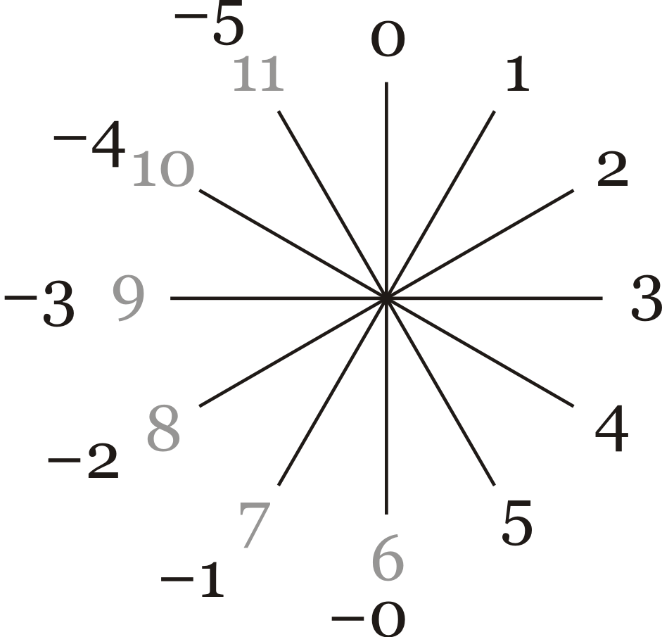
Signed types
This is similar to marking the hours of a clock as follows:
Unfortunately, this leads to ugly arithmetic operations…
–1 + 1 = 0 or –0, but 7 + 1 = 8
–5 + 2 = –3, but 11 + 2 = 1

Slide 39
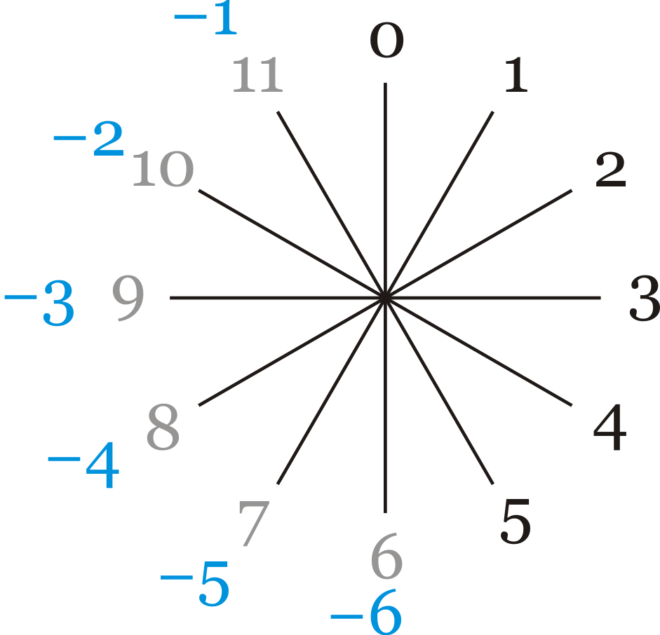
Signed types
A better solution:
Note that
–1 + 1 = 0, but also 11 + 1 = 0
–5 + 2 = –3, but also 7 + 2 = 9, which we are equating to –3

Slide 40
Signed integers
Here is a workable solution:
If the leading bit is 0:
Assume the remainder of the number is the integer represented
For short, this includes
0000000000000000 0
0111111111111111 2¹⁵ – 1 = 32767
This includes 2¹⁵ different positive numbers
If the leading bit is 1:
Assume the number is negative and its magnitude can be found by applying the 2’s complement algorithm
Recall the 2’s complement algorithm is self-inverting

Slide 41
Signed integers
For negative numbers stored as a short:
1000000000000000
0111111111111111
+ 1
1000000000000000
This is the representation of the largest negative number: –2¹⁵
1111111111111111
0000000000000000
+ 1
0000000000000001
This is the representation of the smallest negative number: –1

Slide 42
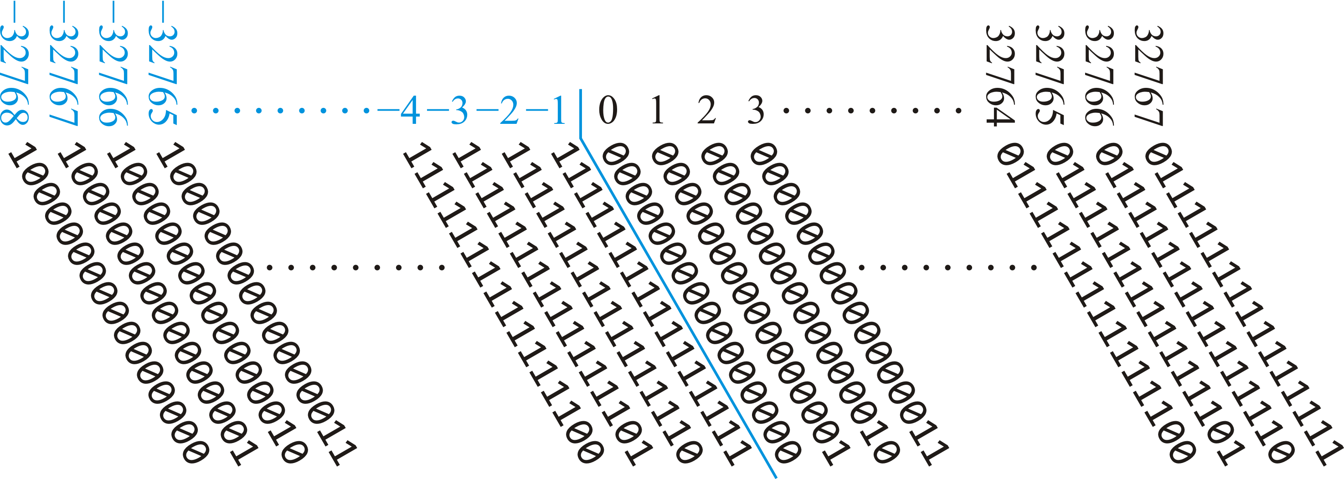
Signed integers
Here, you can compare these two techniques
In both cases, we go from –12/2 to 12/2 – 1 and –2¹⁶/2 to 2¹⁶/2 – 1

Slide 43
Signed integers
For example, 1111111111010110 is a negative short
1111111111010110
0000000000101001
+ 1
0000000000101010
Thus, it represents –42
Let’s calculate –42 + 91 = 49 and –42 – 91 = –133:
1111111111010110
+ 0000000001011011
10000000000110001
1111111111010110
+ 1111111110100101
11111111101111011
49
–91
133
–133
10000101

Slide 44
Summary
To summarize:
Integer types are stored as either 1, 2, 4 or 8 bytes
Negative numbers are stored in the 2’s complement representation
Type | Bytes | Bits | Range | Approximate Range
unsigned char | 1 | 8 | 0, …, 2⁸ – 1 | 0, …, 255
unsigned short | 2 | 16 | 0, …, 2¹⁶ – 1 | 0, …, 65535
unsigned int | 4 | 32 | 0, …, 2³² – 1 | 0, …, 4.3 billion
unsigned long | 8 | 64 | 0, …, 2⁶⁴ – 1 | 0, …, 18 quintillion
signed char | 1 | 8 | –2⁷, …, 2⁷ – 1 | –128, …, 127
short | 2 | 16 | –2¹⁵, …, 2¹⁵ – 1 | –32768, …, 32767
int | 4 | 32 | –2³¹, …, 2³¹ – 1 | –2.15 billion, …, 2.15 billion
long | 8 | 64 | –2⁶³, …, 2⁶³ – 1 | –9 quintillion, …, 9 quintillion

Slide 45
Non-standards sizes
While common, the C++ standard does not require these sizes:
Each compiler may choose sizes so long as the following are true:
assert( sizeof( char ) == 1 );
assert( sizeof( short ) >= 2 ); // At least 16 bits
assert( sizeof( int ) >= sizeof( short ) );
// At least as large as 'short'
assert( sizeof( long ) >= 4 ); // At least 32 bits
assert( sizeof( long long ) >= 8 ); // At least 64 bits
In gnu g++, the sizes are as we have described in this slide deck
In Microsoft Visual Studio, however:
A long is only four bytes (same as int)
A long long is eight bytes
We do not use long long in this course
You may have to use it if you program in Visual Studio

Slide 46
Standard sizes
If you want a guarantee that an integer type is of the size you want:
Use the cstdint (C standard integer) library
The following types are defined:
The suffix _t indicates that this is a defined type
For example:
int8_t small{0};
Bytes | Signed | Unsigned
1 | int8_t | uint8_t
2 | int16_t | uint16_t
4 | int32_t | uint32_t
8 | int64_t | uint64_t

Slide 47
Summary
Following this lesson, you now
Understand the representation of unsigned integers
Know how to perform subtraction using 2’s complement
Similar to 10’s complement used a century ago
Understand that signed integers store negative numbers in their 2’s complement representation
Know that char is actually just an integer type
It can be interpreted as a printable character if necessary
Understand the ranges stored by char, short, int and long

Slide 48
References
[1] Wikipedia
https://en.wikipedia.org/wiki/Integer_(computer_science)
https://en.wikipedia.org/wiki/Two%27s_complement

Slide 49
Acknowledgments
Theresa DeCola and Charlie Liu.

Slide 50



Colophon
These slides were prepared using the Georgia typeface. Mathematical equations use Times New Roman, and source code is presented using Consolas.
The photographs of lilacs in bloom appearing on the title slide and accenting the top of each other slide were taken at the Royal Botanical Gardens on May 27, 2018 by Douglas Wilhelm Harder. Please see
https://www.rbg.ca/
for more information.

Slide 51
Disclaimer
These slides are provided for the ece 150 Fundamentals of Programming course taught at the University of Waterloo. The material in it reflects the authors’ best judgment in light of the information available to them at the time of preparation. Any reliance on these course slides by any party for any other purpose are the responsibility of such parties. The authors accept no responsibility for damages, if any, suffered by any party as a result of decisions made or actions based on these course slides for any other purpose than that for which it was intended.

